Slide 1
Real Time Parking Space Availability
Gopi Sai Surekha Kotiyala
With
Dr. Terry Griffin
Midwestern State University
Notes:
1

Slide 2
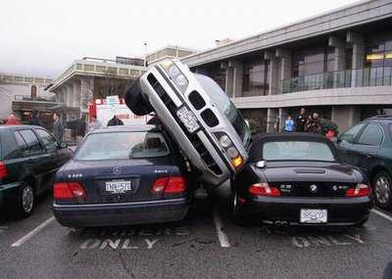

Problem
Late for class … again.
Notes:
2

Slide 3
Motivation
Available parking spaces are elusive.
Location Based Services are easy to implement.
Identifying available parking is not easy to implement, but possible, and has an expressed need.
Notes:
3

Slide 4
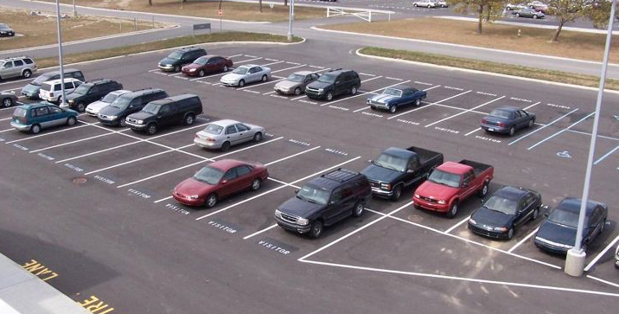
Overview
Identifying Available Parking Spaces has three stages:
Automatic parking space discovery
Identifying spaces as available
Mobile application showing results
Notes:
4

Slide 5
Some Terminology
Filtering
Edge Detection
Object Detection
Corner Detection
Line Detection
Color Identification
Notes:
5

Slide 6

Application
( on a clean image)
Notes:
6

Slide 7
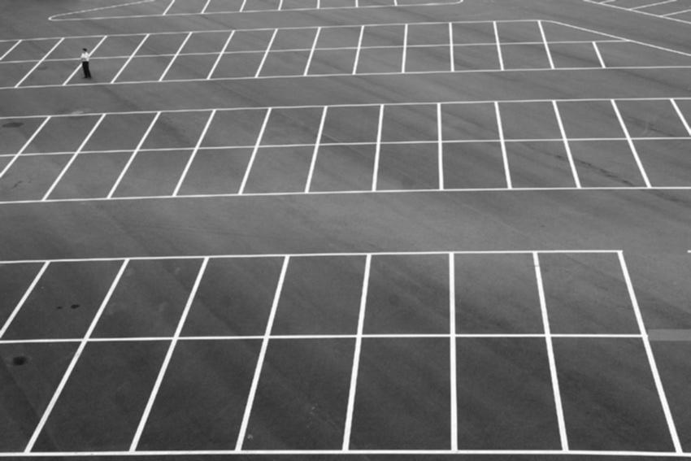
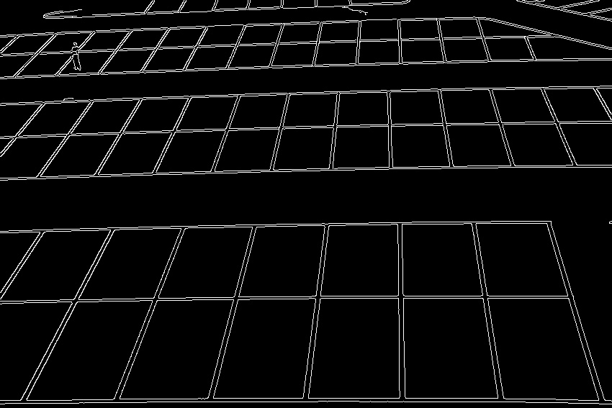
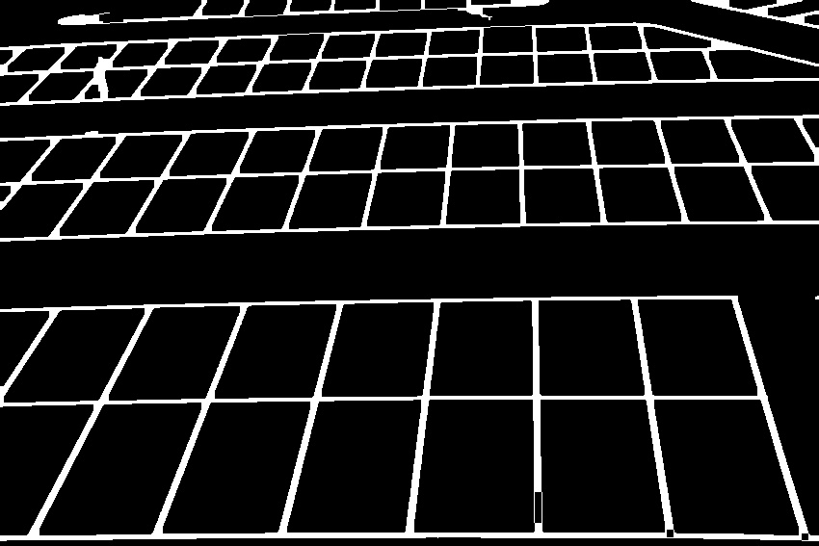
Application
( filters )
Original
Gray Scale
Edged
Closed
Notes:
7

Slide 8
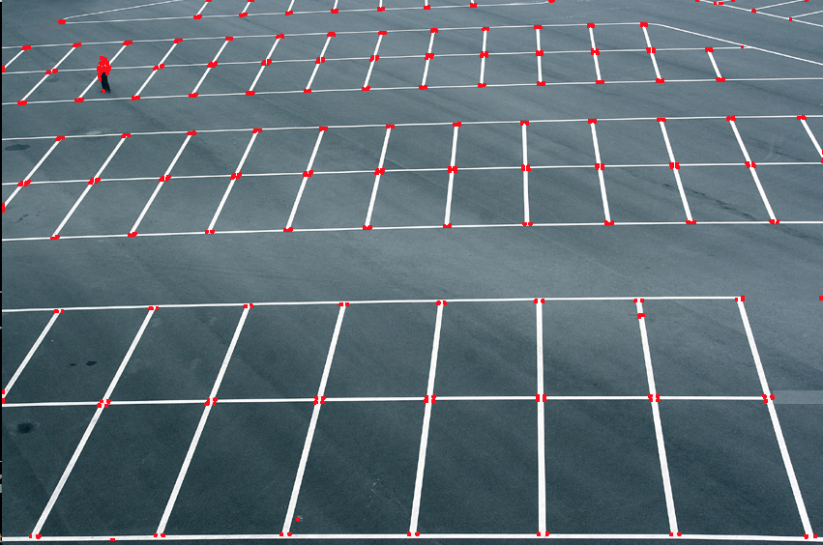
Application
( Corners)
Corner Detection
Notes:
8

Slide 9
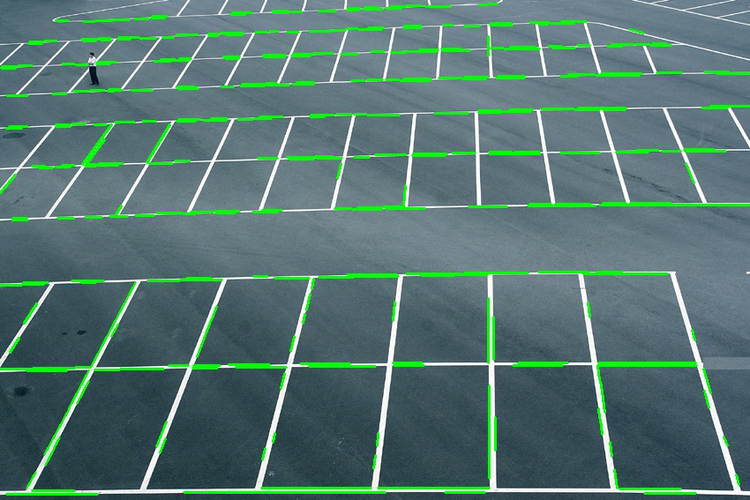
Application
( Lines)
Line Detection
Notes:
9

Slide 10
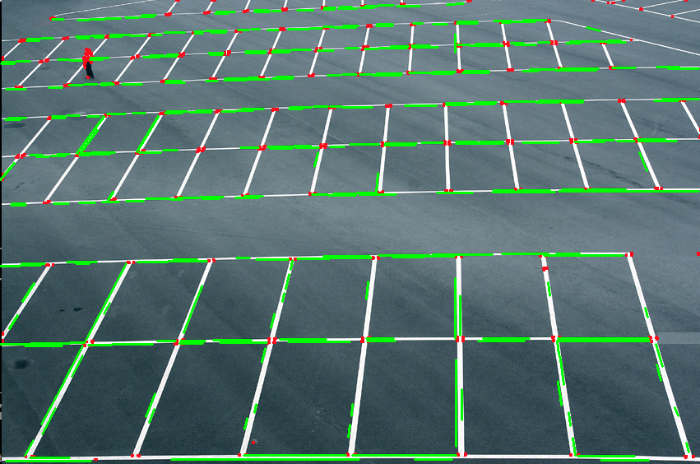
Application
( Lines and Corners)
Notes:
10

Slide 11
Problems
A real time robust parking space identification algorithm is possible, but not 100%
We choose to move to Stage 2
Automatic parking space discovery
Identifying spaces as available
Mobile application showing results
Notes:
11

Slide 12
Identifying spaces
Physically identifying the spaces.
Calculating the average color by identifying the colors.
Setting some threshold value.
Finally, detecting the empty spaces.
Notes:
12

Slide 13
Identifying spaces

Slide 14




Identifying colors
Gray Scale
Color
Color
Gray Scale
[r]=>57 [g]=>57 [b]=>57
[r]=>38 [g]=>64 [b]=>71
[r]=>90 [g]=>111 [b]=>122
[r]=>106 [g]=>106 [b]=>106
Example Space
Dark
Example Space
Light

Slide 15

Identifying colors
0.42, 0.49, 0.52 | 0.43, 0.49, 0.52 | 0.21, 0.29, 0.33 | 0.43, 0.51, 0.53 | 0.21, 0.29, 0.33 | 0.21, 0.29, 0.33
0.29, 0.24, 0.30 | 0.21, 0.29, 0.33 | 0.21, 0.29, 0.33 | 0.21, 0.29, 0.33 | 0.21, 0.28, 0.33 | 0.21, 0.29, 0.33
0.21, 0.29, 0.33 | 0.28, 0.23, 0.35 | 0.21, 0.29, 0.33 | 0.24, 0.28, 0.37 | 0.21, 0.29, 0.33 | 0.21, 0.29, 0.33
0.21, 0.29, 0.31 | 0.21, 0.29, 0.35 | 0.21, 0.29, 0.52 | 0.21, 0.29, 0.34 | 0.21, 0.29, 0.33 | 0.21, 0.28, 0.30
0.21, 0.29, 0.33 | 0.21, 0.29, 0.33 | 0.21, 0.29, 0.33 | 0.45, 0.53, 0.56 | 0.21, 0.27, 0.33 | 0.21, 0.29, 0.33
0.21, 0.29, 0.13 | 0.21, 0.29, 0.33 | 0.21, 0.24, 0.53 | 0.21, 0.25, 0.33 | 0.21, 0.26, 0.33 | 0.21, 0.29, 0.33
0.21, 0.29, 0.33 | 0.21, 0.29, 0.33 | 0.21, 0.29, 0.33 | 0.21, 0.29, 0.33 | 0.21, 0.29, 0.33 | 0.21, 0.29, 0.33
0.21, 0.29, 0.43 | 0.21, 0.29, 0.53 | 0.21, 0.29, 0.33 | 0.21, 0.29, 0.33 | 0.21, 0.29, 0.53 | 0.21, 0.20, 0.33
0.21, 0.31, 0.33 | 0.21, 0.30, 0.33 | 0.21, 0.23, 0.33 | 0.21, 0.21, 0.33 | 0.21, 0.34, 0.33 | 0.21, 0.32, 0.33
0.21, 0.29, 0.33 | 0.21, 0.29, 0.33 | 0.21, 0.29, 0.33 | 0.21, 0.29, 0.33 | 0.21, 0.29, 0.33 | 0.42, 0.49, 0.52

Slide 16
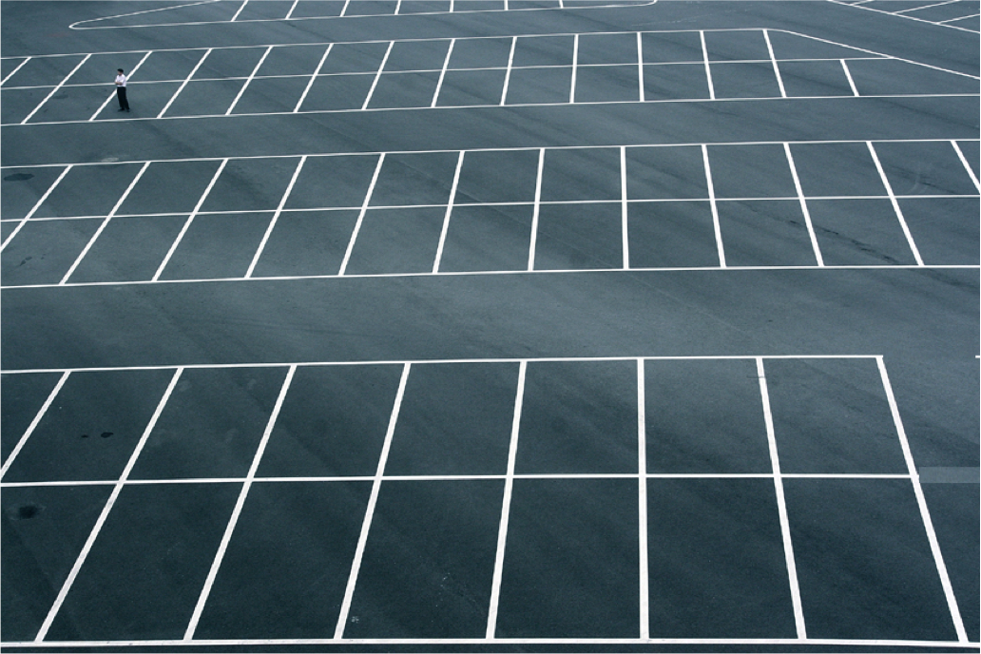
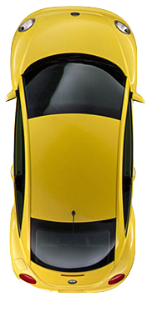
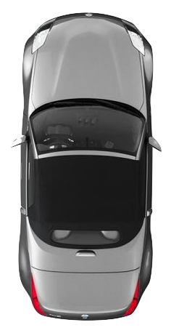
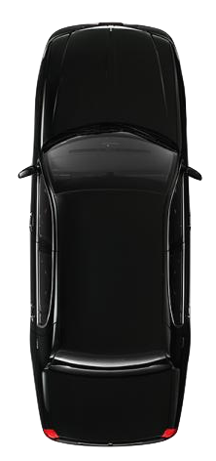

Slide 17


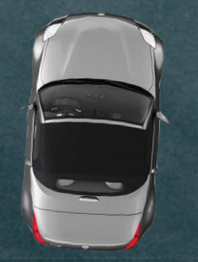
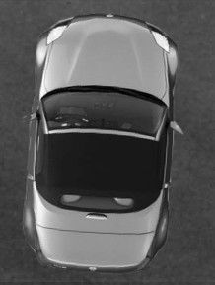
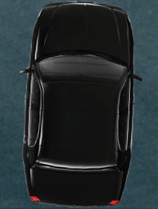
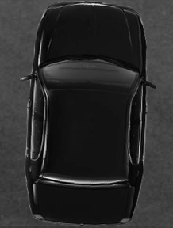
Results
.40 Yellow.27 = Baseline Silver Car = .34 Black Car = .17
[r]=>80 [g]=>90 [b] => 93
[r]=>87 [g]=>87 [b] => 87
[r]=>51 [g]=>76 [b] => 83
[r]=>69 [g]=>69 [b] => 69
[r]=>38 [g]=>47 [b] => 49
[r]=>45 [g]=>45 [b] => 45

Slide 18
Threshold values
Climates

Slide 19
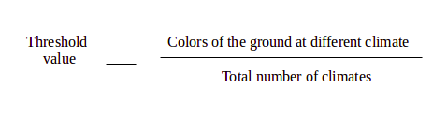
Threshold value
The threshold value is set, by using the following formula:
Notes:
19

Slide 20
Future Work
Designing a Mobile application for showing the available parking spaces in different platforms.
Displaying on a screen about the availability of parking space with image.
Using drone in a parking space.
Notes:
20

Slide 21
Conclusion
Easy to locate the available spaces at parking area.
Helps students and faculties for parking easily.
Saves time.
Notes:
21

Slide 22

Queries??????
Notes:
22

Slide 23
References
Mexas, A H., Marengoni, M., Unsupervised Recognition of parking lot areas, Proceedings of the International Conference on Machine Vision and Machine Learning Prague, Czech Republic, August 14-15, 2014.(Paper No. 68).
Yusnita, R., Norbaya, F., Basharuddin, N., Intelligent Parking Space Detection System Based on Image Processing, International Journal of Innovation, Management and Technology, Vol. 3, No. 3, June 2012.
Zabawi, N H B., Sunardi., Ghazali, K H., Parking lot detection using image processing method,ICLTEEE 2013.
Comaniciu, D., Meer, P., Robust Analysis of feature spaces: Color Image Segmentation, Department of Electrical and Computer Engineering Rutgers University, Piscataway, NJ 08855, USA.
Manzanera, A., Local jet feature space framework for image processing and representation, Laboratoire d’Electronique et Informatique ENSTA-ParisTech, Paris, France.
Canny, J., A computational approach to edge detection, proceeding IEEE transactions on pattern analysis and machine intelligence, vol. pami-8, no.6, November 1986.
Torres, F.A.J., Automatic parking lot occupancy computation using motion tracking, the college of engineering and computer science in partial fulfillment of the requirements for the degree of master of science, Florida Atlantic university, Boca Raton, Florida, august 2013.
Papanikolopoulos, N.P., martin, R.F.K., Masoud, O., Gupte, S., Detection and classification of vehicles, IEEE transactions on intelligent transportation systems, vol.3, no.1, march 2002.
Lindberg, T., Feature detection with automatic scale selection, Computational vision and active perception laboratory (CVAP), Department of numerical analysis and computing science, KTH (royal institute of technology), S-100 44 Stockholm, Sweden, received February 1, 1994; revised june 1, 1996; accepted july 30, 1998.
Notes:
23

Slide 24

Special Thanks to
Dr. Terry Griffin
Notes:
24

